Slide 1
Introduction to Java

Slide 2
Why Java?
Runs on more than 5.5 billion devices. Java is versatile and applicable to Web Development, Mobile Apps (Android), Desktop Applications, IOT Devices and more.
Java's OOP implementation is widely regarded as robust and effective.
Enterprise and Large-Scale Systems. Java is trusted for its stability, scalability, and security in mission-critical projects.
Platform Independency allows Java to compile it’s code once and run in any OS with a JVM (Java Virtual Machine).

Slide 3
Platform Independency - A key feature of Java
In order to understand Platform Independency, we must know about three core components of Java and understand how Java executes its codes.
JVM (Java Virtual Machine) is platform dependent interpreter. This is the component that executes bytecode. Mac, Linux, Windows each has different JVMs.
JRE (Java Runtime Environment) contains the environment and libraries that JVM uses to execute Java programs. JRE includes JVM as well. JRE is required to RUN any java program.
JDK (Java Development Kit) contains various tools for developers like Java Compiler (javac) , Java Debugger (jdb) etc. JDK is required for coding and developing Java applications. JRE is included with JDK.

Slide 4
Platform Independency (Contd.)
Java code goes through the compiler within the JDK.
Compiler converts Java Code to Byte Code which is platform independent. Now this ByteCode can be run in any OS without compiling.
This ByteCode (.class file) is executed by the JVM using various libraries from the JRE.
JDK
Source Files
(.java) files
Byte Code
(.class) files
JRE
Compiler
JVM
Libraries
Debugger

Slide 5
Installing JDK & DrJava
For this course we’ll be using JDK version 8.
Link to JDK version 8:
https://www.openlogic.com/openjdk-downloads
We’ll be using DrJava as IDE:
Link to DrJava:
https://drive.google.com/file/d/1bNB0VWxQPOJ1SFmA9nFwHt_TRhm3JvVu/view

Slide 6
Writing Your First Program
Let’s write our first program using Java
public class FirstProgram {
public static void main (String [] args){
System.out.print(“Hello World“);
}
}
This program will print out “Hello World”.
PS: For now you have to memorize the highlighted portion.
Don’t worry, all of it will make sense by the end of this course.
Welcome to DrJava. Working directory is /home/Documents
> run FirstProgram
Hello World!!

Slide 7
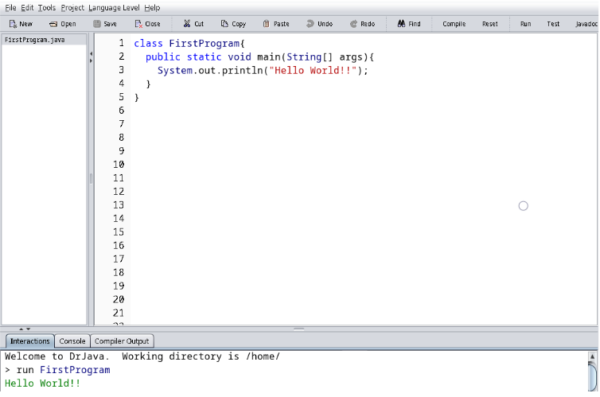
Running Java code using DrJava
1
2
3
After writing our code using Dr Java’s editor, we have to
Save the code.
Compile the code.
Run the code.
Keep in mind, your file name has to be the same as the Class name.
In this example, FirstProgram is our class name.

Slide 8
Printing in Java
To show the output in the console, java uses three different approaches.
prints any argument passed to it while keeping the cursor on the same line
System.out.
print()
refers to the output stream
prints any argument passed to it followed by a line break
System.out.
println()
System.out.
printf()
prints the output in a specified format

Slide 9
Printing in Java (Contd)
public class PrintingExample{
public static void main(String[] args) {
float y = 1.56f;
System.out.print("Number: " + 23);
System.out.println("Hello World");
System.out.printf("Formatted y = %.4f\n", y);
}
}
Welcome to DrJava. Working directory is C:\Users\Desktop
> run PrintingExample
Number: 23Hello World
Formatted y = 1.5600

Slide 10
Comments in Java
Comments are used to make the code more readable and easily understandable.
The commented portions of code are ignored by the java compiler.
Single line comments: Two forward slashes (//) are used at the beginning of the line.
Multi-line comments: It starts with /* and ends with */

Slide 11
Comments in Java (Contd)
public class Comments{
public static void main(String[] args) {
// This is an example of single-line comment
System.out.println("Comments in Java");
/* This is an example of
multi-line comments */
System.out.println("Program ends!");
}
}
Welcome to DrJava. Working directory is C:\Users\Desktop
> run Comments
Comments in Java
Program ends!

Slide 12
Java Keywords
Java Keywords are few reserved words that have predefined meanings and can not be used as variable names. Let’s get to know some of them.
public : An access modifier keyword. It means the class/method is accessible from any other classes. Private and Protected are other types of access modifiers.
class : keyword is used to specify the classname. In our example, class FirstProgram means that FirstProgram is the classname.
public class FirstProgram {
public static void main (String [] args){
System.out.print(“Hello World“);
}
}

Slide 13
Java Keywords (Contd)
void : This keyword means nothing will be returned from the method. We’ll learn more about these in the later lectures.
static : It means the method can be invoked without creating an instance of the class. Again, it’ll all make sense when we learn about these in the upcoming lectures.
public class FirstProgram {
public static void main (String [] args){
System.out.print(“Hello World“);
}
}
Java keywords list: https://www.javatpoint.com/java-keywords

Slide 14
Java Scopes
In Java, scopes define the visibility and lifetime of variables, methods, and classes. Primarily these scopes are defined using { } (Curly Braces).
As shown in the example, after declaring the classname “FirstProgram” in the line 1, “{“ was used. It meant everything below was within Class Scope until the bracket was closed in line 5 using “}”.
public class FirstProgram {
public static void main (String [] args) {
System.out.print(“Hello World“);
}
}
Note: We’ll learn more about scopes in the Branching and Loop chapters.

Slide 15
Java printf to format output (Additional Reading)
https://www.theserverside.com/blog/Coffee-Talk-Java-News-Stories-and-Opinions/How-to-use-Java-printf-to-format-output

Slide 16
THANK YOU!

